Slide 1
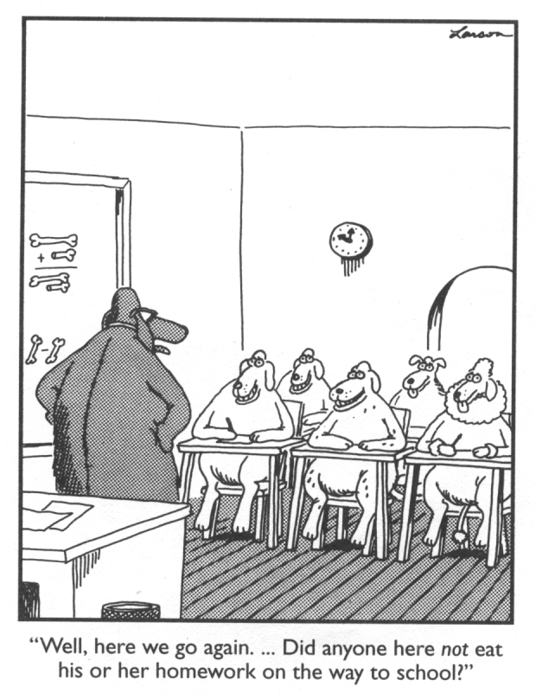

Slide 2
Notes:
Move around room when music is playing. When music stops, form a group of 3. Each person should share one good thing that happened today at school and one good thing that happened over the weekend.

Slide 3
Our Norms
Delay distractions
Problems come with solutions
Presume positive intentions
Take responsibility for your own
learning & growth
One Big Red, one mic

Slide 4
Today’s Content Objectives a.k.a. The “What”
Demonstrate a working knowledge of the scoring rubric.
Draw conclusions about student needs based on a small sample of pre-assessments.
Recommend activities and strategies to be used throughout ILCs to improve student writing skills.

Slide 5
Today’s Language Objectives a.k.a. The “How”
Explain how we used the rubric to score student writing.
State and justify opinions about scoring student writing.
Brainstorm lesson ideas for teaching writing in our respective content areas.

Slide 6
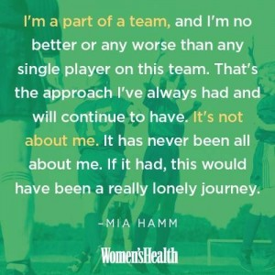
Part 1 – Team building, resource sharing, & whatnot

Slide 7
Tech Tool: Plotagon
https://plotagon.com/

Slide 8
CLASS Data Collection
Sign up for an observation date
You’ll be observed for one day
Plan to be in your classroom, not the computer lab
Data will be shared in December

Slide 9
Evaluations
ILC data can be used to show student growth in your classroom

Slide 10
Notes:
https://www.youtube.com/watch?v=8vTIY0xHBUg

Slide 11
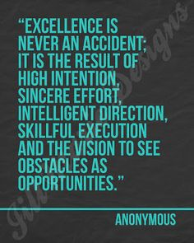

Slide 12
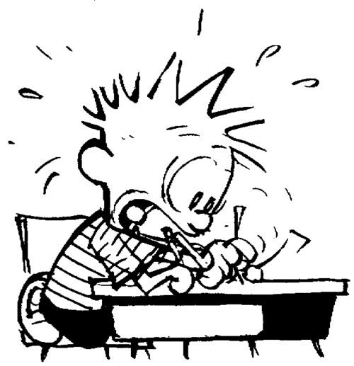
Part 2 – What does good writing
look like at Sexton?

Slide 13
Students will be able to …
Write informative/explanatory texts, including the narration of historical events, scientific procedures /experiments, or technical processes.
“Anchor Standard”
Share with students!

Slide 14
6 Areas of Emphasis
Focus
Development
Audience
Cohesion
Language
Style
Notes:
Refer to rubric

Slide 15
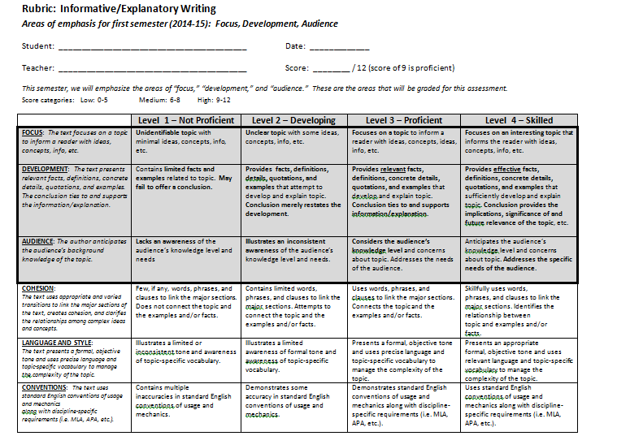

Slide 16
Practice
Read student writing samples and score them using the rubric (individually)
Compare scores with people at your table
Come to a “consensus score” for each sample
Be prepared to justify your scores
According to these texts, what effect did the American civil rights movement have on people who lived through it? Be sure to use evidence from the texts to support and develop your thinking.

Slide 17
Reflection
On a scale from 1 (easy) to 5 (nearly impossible!), how difficult was it for your group to reach consensus on a score?
How can we become more consistent individually and as a staff when it comes to scoring with a rubric?

Slide 18
By Department…
Answer these questions on a piece of big paper:
Right now, what do the students know, and what are they able to do (when it comes to writing)?
What needs to happen in the classroom so all students can do this and similar tasks well?
How do our expectations shift when considering grade level?

Slide 19
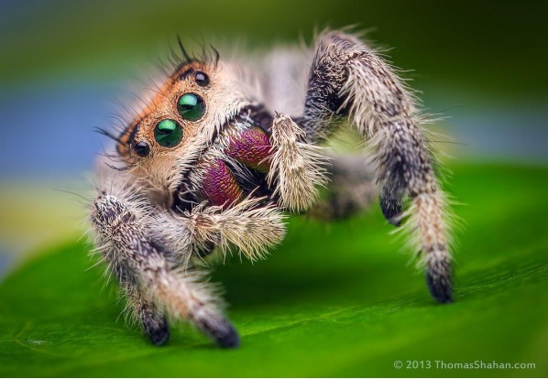
Break time!

Slide 20
Part 3 – This semester’s ILCs
From our School Improvement Plan:
Student proficiency will increase by 25 percent in reading and writing on the spring 2015 assessments.
Notes:
Outline/calendar of ILCs #1 & #2
“I can” statements = measureable skills to be taught over the course of the year

Slide 21
How?
SIOP lessons / activities
Not just for ELL students, but for all struggling students
Expectation is still here that content & language objectives are posted and discussed daily in class.
Change “SWBAT” to “I can….”
“Talk to the Text,” other active reading strategies
Exit tickets ☺
Notes:
Review SIOP elements (handout)
SIOP lesson plan templates
Sample lesson – would it be helpful to receive a generic lesson plan each week of the first ILC?

Slide 22
Planning Time in Departments
Use ILC calendar and SIOP materials as guides
Complete “Sexton ILC Planning Worksheet” as a group – turn in one per department at the end of the session

Slide 23
Recap
Plotagon
CLASS observation sign-up sheets
Evaluation
Writing standard
Rubric
ILCs
SIOP
Activities/lessons for ILCs

Slide 24
Reminder:
We want students to become better writers. To do this, they must write and write and write, in all content area classes.
Notes:
Not all writing has to be graded.
Journals
Exit tickets

Slide 26
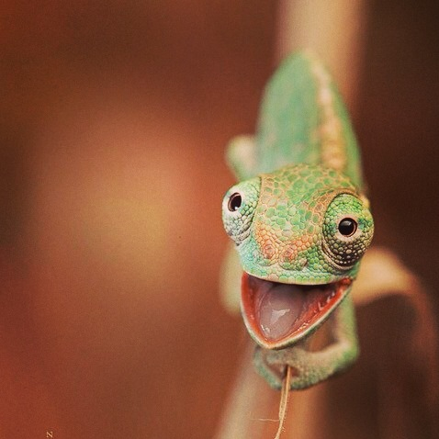
Thank you &
enjoy the rest
of your day.

