Slide 1
ILC #4: Return of the Exit Tickets!
Content Objectives for Today (WHAT):
Identify the components of ILC #4
Analyze teacher & student data from ILC #3
Language Objectives for Today (HOW):
Read documents that outline ILC #4
Watch video that demonstrates presentation of objectives
Discuss teacher & student data
Describe exit ticket strategies that work for you

Slide 2
Content & Language Objectives
Reminder: All departments committed to posting content & language objectives daily as part of their integration of SIOP elements into the classroom
Should reflect what is going on in classroom
Content objectives = WHAT
Language objectives = HOW

Slide 3
ILC #4 – Repeat of ILC #3
Content & language objectives on board each day
Explanation of objectives to class at beginning of hour
3rd hour classes (if you don’t have a 3rd hour, please choose another hour to work with)
Exit tickets at least once a week

Slide 4
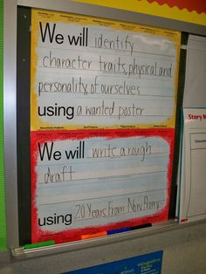
Content & Language Objectives - Examples

Slide 5
SIOP Model – Lesson Delivery
http://youtu.be/lVGbz4EqyGs
Notes:
Watch first 3:15 minutes of video

Slide 6
Exit Tickets
Think-Write-Pair-Share
Questions to think about & discuss:
Describe an exit ticket strategy that worked well for you
How did you overcome challenges related to the exit ticket strategy?
What new kind of exit ticket might you try in ILC #4?

Slide 7
How did it go in ILC #3?

Slide 8
Teacher Responses to Final Survey
Responses from 21 teachers – 58% response rate
Our goal is 100% participation in the ILC process – implementation, evidence collection

Slide 9
While we look at the data…
Please fill out the sheet labeled “Data Dig, ILC #3” as you look at the next several slides
Be prepared to discuss
Please turn in your sheet at the end of the meeting
The big question is…What improvements/adjustments will make this ILC more meaningful for teachers and students?

Slide 10
Teacher Responses to Final Survey

Slide 11
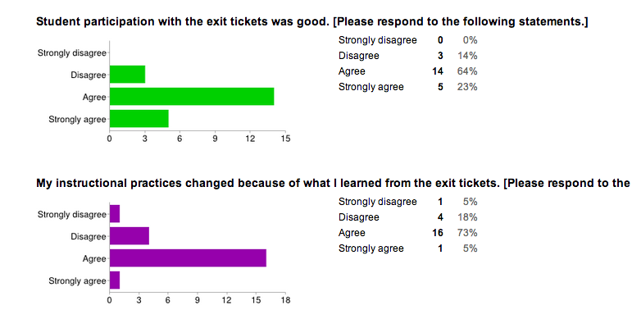
Teacher Responses to Final Survey, continued…

Slide 12
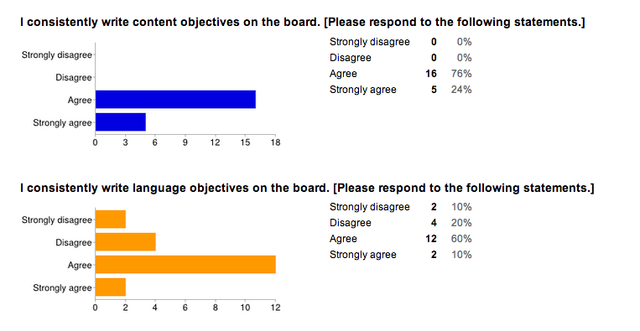
Teacher Responses to Final Survey, continued…

Slide 13
Teacher Responses to Final Survey, continued…

Slide 14
Student Survey Results for ILC #3
474 surveys completed
Surveys turned in by 28 teachers (out of 36 who have classes during 3rd hour – 78%)

Slide 15
Student Survey Results for ILC #3, continued…
87%
13%

Slide 16
Student Survey Results for ILC #3, continued…
80%
20%

Slide 17
Student Survey Results for ILC #3, continued…
48%
52%

Slide 18
Student Survey Results for ILC #3, continued…
9%
51%
12%
18%
10%

Slide 19
Student Survey Results for ILC #3, continued…

Slide 20
Student Survey Results for ILC #3, continued…
6%
3%

Slide 21
Data dig: What jumps out at you?
Positives
Areas for improvement
Adjustments for ILC #4 – what can we do differently to make this more meaningful and impactful for students?

